Slide 1

Ride Fare Forecasting
Varsha Hindupur - 002935078
Raunak Balchandani - 002964444

Slide 2
Goal of the problem
This project seeks to develop a predictive model for estimating fares for future rides on Lyft and Uber. The model takes account various factors that influence ride fares, such as distance, weather conditions, time of day, and day of the week. By integrating these diverse variables into the fare estimation process, we aim to build a more sophisticated and accurate pricing model for these popular ride-sharing services
The wealth of data accumulated by Uber and Lyft due to their extensive customer base presents an opportunity to manage and analyze this data effectively. This allows for the identification of pertinent data points and extraction of valuable insights, which can be harnessed to tackle business challenges such as predicting ride fares.
The objective of this predictive model is to generate fares that prioritize customer trust and satisfaction, while also considering the comfort of the driver. The ultimate goal is to create a pricing model that fosters customer loyalty and satisfaction while ensuring a positive experience for both passengers and drivers.

Slide 3
Problem Statement
The current fare calculation system used by Uber and Lyft only takes the account of the distance traveled. However, several issues commonly arise when booking a ride that are not captured by this simplistic approach. These includes challenges such as:
Bad Weather Conditions
Traffic Conditions
Booking time
Changes in the pickup point/unreachability of pickup point
Distance between source & destination
Gas and vehicle maintenance costs
Customer satisfaction score

Slide 4
Libraries & Packages Used
Pandas: A powerful library that provides easy-to-use data structures and data analysis tools for data manipulation and analysis in Python. It's particularly useful for working with tabular data.
NumPy: A library that provides efficient numerical computation in Python. It offers a powerful array data structure and a vast array of mathematical functions for efficient computations.
Scikit-learn: A versatile machine learning library that provides a wide range of tools for classification, regression, clustering, and dimensionality reduction. It's designed to be user-friendly and easy to use for both beginners and experts.
Matplotlib: A widely-used data visualization library that provides a range of customizable plots, charts, and graphs for displaying data in Python. It's particularly useful for creating publication-quality figures and visualizations.

Slide 5
Implementation
Collecting and Raw Data and Pre-processing
Exploratory Data Analysis
Data Preparation
Recursive Feature Elimination
Feature Selection
Modelling & Testing:
Linear Regression -
Decision Tree -
Gradient Boosting Regressor -

Slide 6
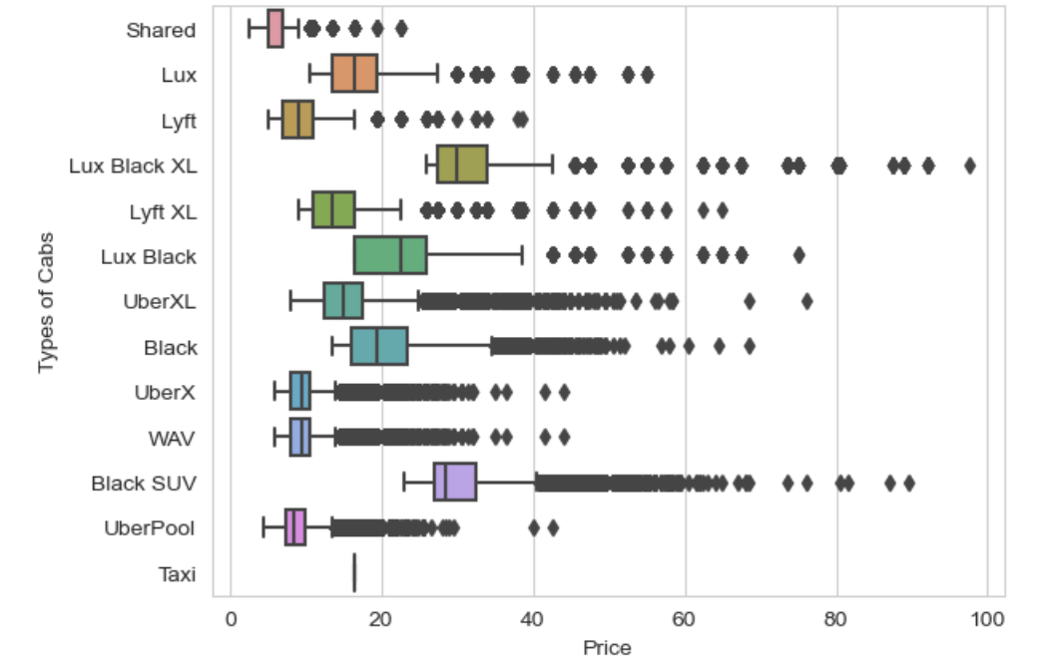
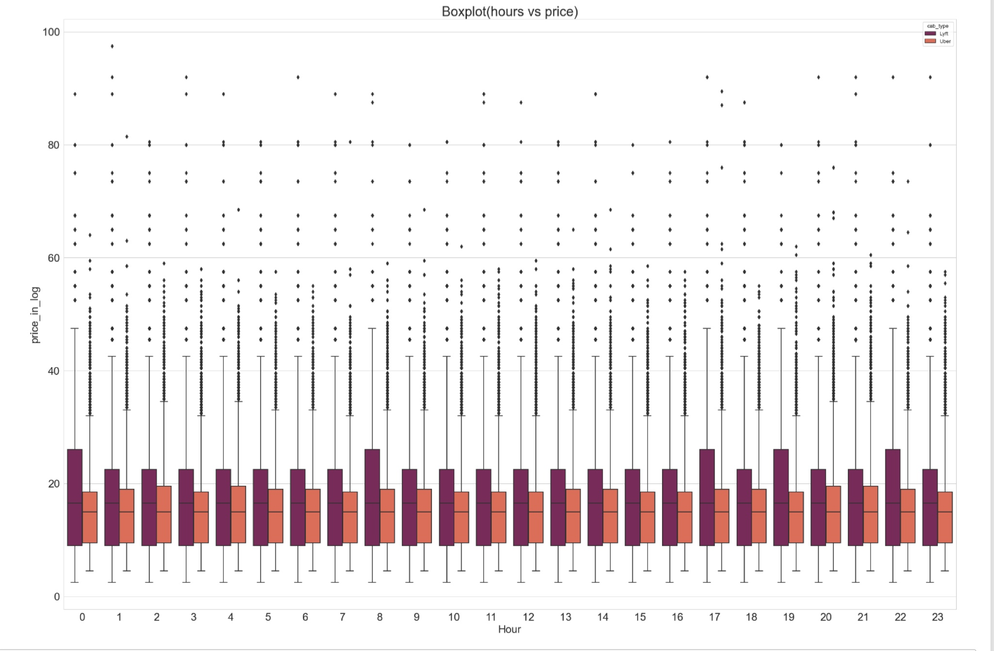
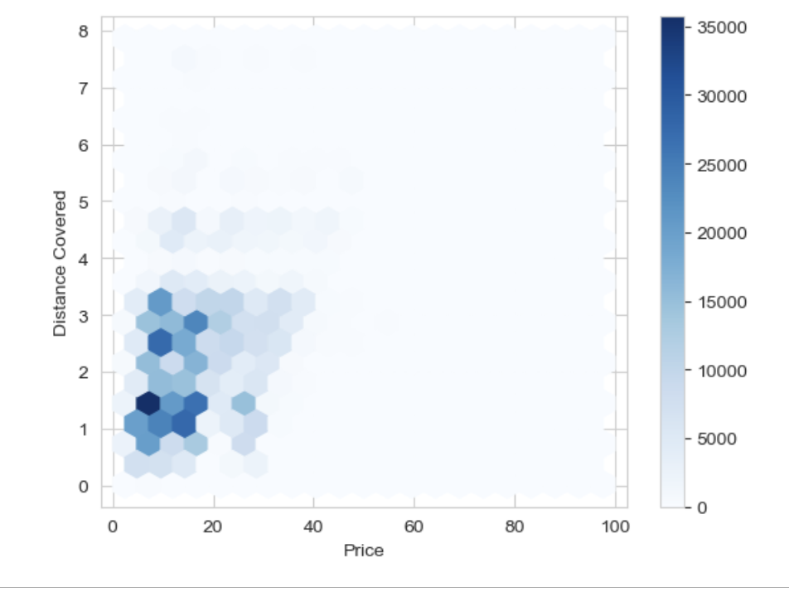
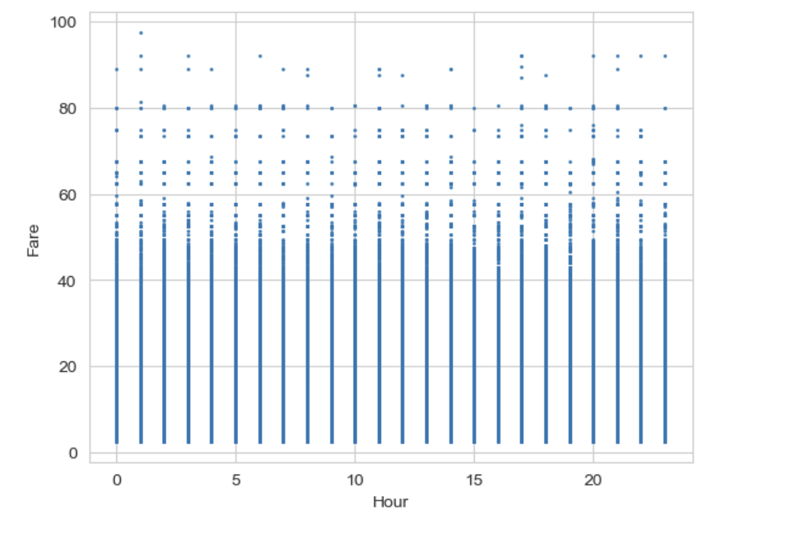
Visuals & Inferences
Prices of Uber v/s Lyft
Price according to car category
Distance v/s Price
Hourly Fare Increase Plot

Slide 7
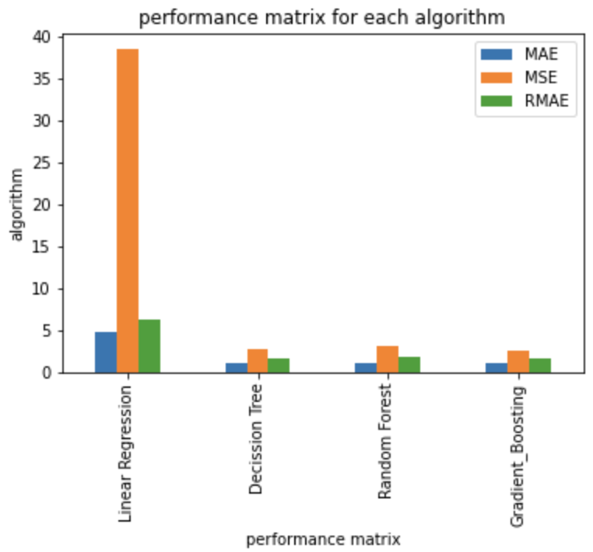
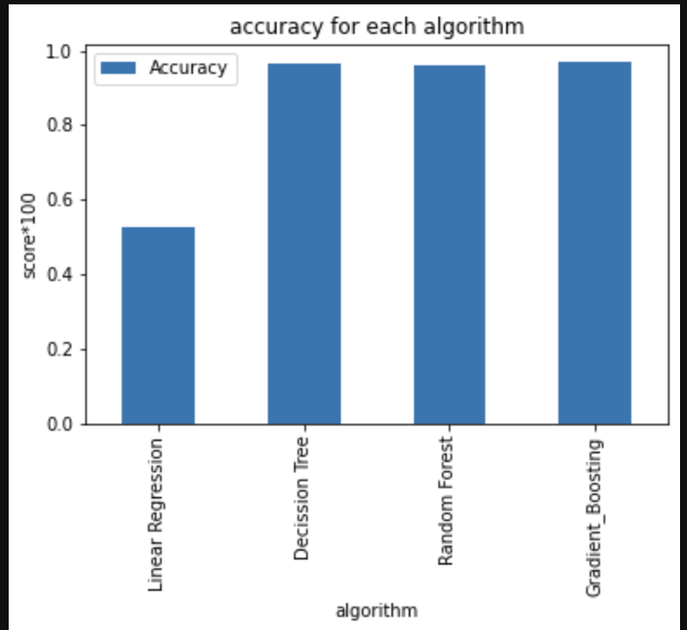
Visuals & Inferences Pt.2
Performance matrix for each algorithm
Model accuracy for each algorithm

Slide 8

Thank you!

